Slide 1

Versions
Current Version: 2.7.3 (Aug 25, 2016)
Version Used: 2.7.1

Slide 2
Agenda
Introduction
History of Hadoop
Hadoop Cluster
Hadoop Key Characteristics
Traditional Systems vs. Hadoop
Hadoop 1.0 vs. 2.0
Hadoop Core Services
Hadoop Architecture
Hadoop Configuration
How Does Hadoop Work?
HDFS
YARN
MapReduce
Summary

Slide 3




Producers | Management | Consumers
Data Streaming
Accept All formats - CSV, LOG, TEXT, Video, Binary etc.
Supporting Different connectors - JDBC, ODBC, FTP etc
Various Types of Syncs - PULL , PUSH and POLLING. Can load data in full or incremental.
Data Manager
Data Pipeline
Contextual Tagging for ease of search.
Data Cleansing and Scrubbing
Scheduled processing & transformations
Storage
Format / Schema free storage.
Automatic backup to shadow clusters
Fault tolerant
Data Governance
Data lifecycle management.
Easily manipulate and transforms data
Ensure data quality (eliminate duplicates , monitor the completeness & accuracy)
Archive Data Processor
Predefined APIs to process the data with ease.
Processing stored data based on use case requirement
Predictive Analytics Cluster
Predict the future with past data.
Capable of doing Text & Image Processing.
Clustered Servers for train very large volumes of data
Data Security
Contains Permission Management
Role Based access to Data sets and Services
Flexible to integrate with existing Directory services
Data Service
Processed data can be published in different forms - SOAP,REST, SQL, Streams etc.
Open Source Data
C S V
DATA
S
TREAMI
NG
Data Manager
DATA
SERVICE
Data Storage
JSON
Custom App
TEXT
Real Data Stream
No SQL DB
GDB
Data Governance
Data Pipeline
Third Party Apps
Data Security
XML
Just In Time Feed
Event
Processing
DWG
Predictive
Analytic Cluster
Archive
Data Processor
BI Tools
Existing DW data
RDBMS
Easy to Customize and fine tune
Cloud Deployable
Easily Re-sizeable (small to medium to very large)
Hassel-Free integration with existing Systems like DW, AD etc

Slide 4





























Big Data Ecosystem
Streaming Engines
Data Store
Data Processing
Peripherals
Data Services
Distributions
Cloud Exposure

Slide 5



Introduction
What is Hadoop?
Hadoop is a framework that allows for distributed processing of large datasets across clusters of commodity computers using simple programming models.
Inspired by technical documents on Google File System and MapReduce published by Google.
Doug Cutting discovered Hadoop and named it after his son’s yellow-colored toy elephant.

Slide 6
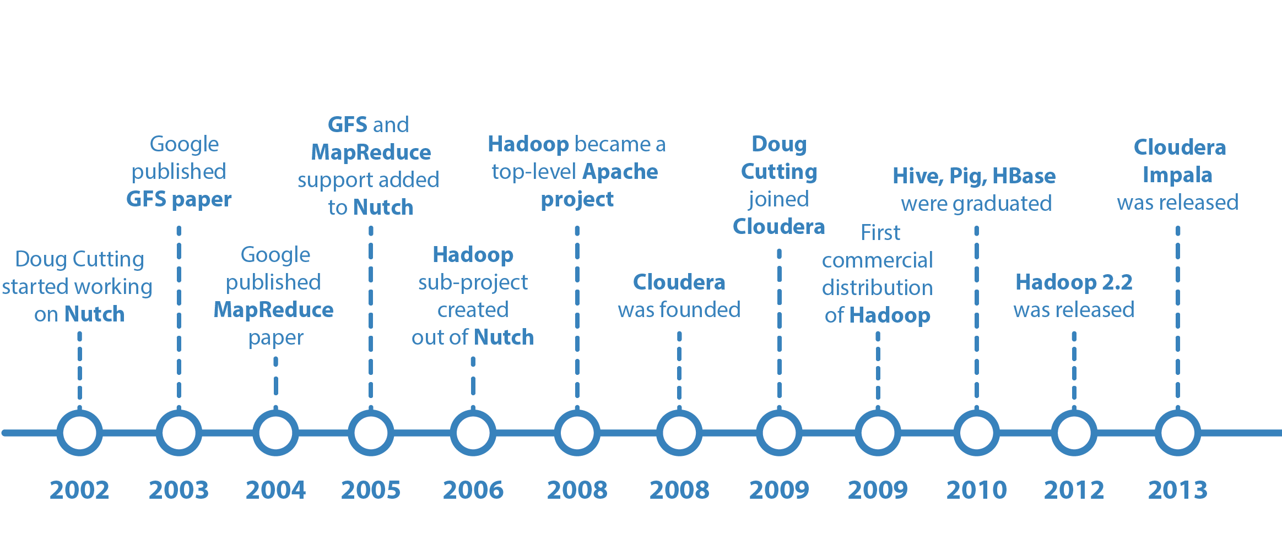
History of Hadoop

Slide 7
Hadoop Cluster
Cluster
Group of independent servers (usually in close proximity to one another) interconnected through a dedicated network to work as one centralized data processing resource.
Hadoop Cluster
A Hadoop cluster is a special type of computational cluster designed specifically for storing and analyzing huge amounts of data in a distributed computing environment.
Distributed processing of large data sets across clusters.
Designed to scale up from single servers to thousands of machines
Each Server offers normal computation and storage power on commodity H/W

Slide 8
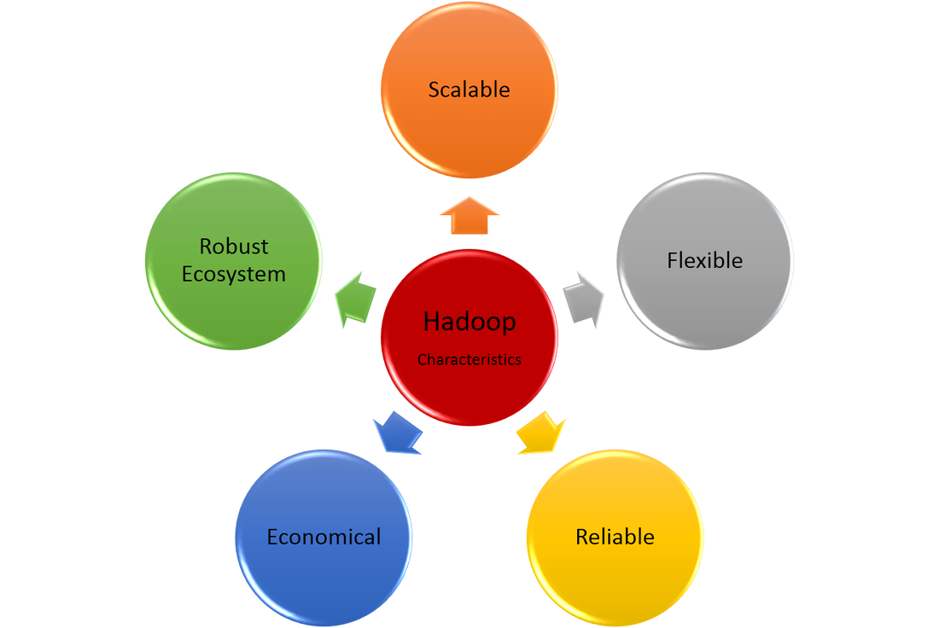
Hadoop Key Characteristics
Scalable
Can follow both horizontal and vertical scaling
Flexible
Can store a lot of data and decide to use it later
Reliable
Stores copies of data on different machines and is resistant to hardware failure
Economical
Ordinary computers can be used for data processing
Robust
Applications will continue to run even when individual servers fail

Slide 9


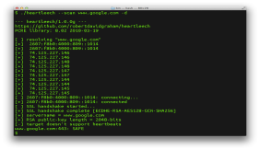

Traditional Database Systems vs. Hadoop
Traditional System
Hadoop
Data sent to the program
Program sent to the data

Slide 10
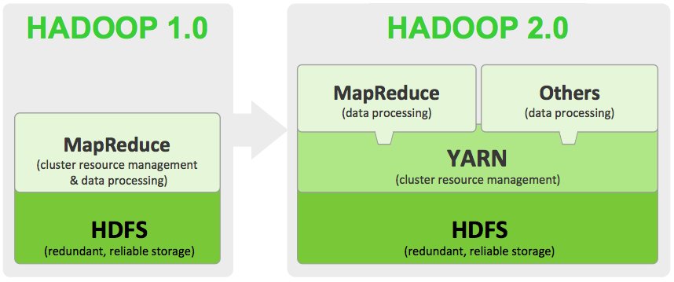
Hadoop 1.0 vs. 2.0

Slide 11
Hadoop Core Services
The core services of Hadoop are:
HDFS
NameNode
DataNode
Secondary NameNode
MapReduce
ApplicationMaster
NodeManager
YARN
ResourceManager
Master
Slave
Name Node
HDFS
Data Node
Data Node
Application Master
MapReduce
Node Manager
Node Manager

Slide 12
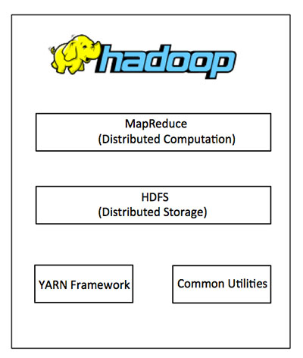
Hadoop Architecture
HDFS - Distributed File System
Yarn - Resource manager
MapReduce - Parallel processing of large data sets
Hadoop Common - The common utilities that support the other Hadoop modules.

Slide 13
Hadoop Configuration
Standalone, pseudo-distributed and fully distributed are three modes of Hadoop configuration.
Standalone mode
All Hadoop services run in a single JVM, on a single machine.
Pseudo-distributed mode
Individual Hadoop services run in an individual JVM, but on a single machine.
Fully distributed mode
Hadoop services run in individual JVMs reside in separate machines in a single cluster.

Slide 14
How Does Hadoop Work?
Stage 1
Submit a job to the Hadoop by specifying the following items:
The location of the input and output files in the distributed file system.
The java classes in the form of jar file containing the implementation of map and reduce functions.
The job configuration by setting different parameters specific to the job.
Stage 2
The Hadoop job client then submits the job and configuration to the JobTracker which then assumes the responsibility of distributing the software/configuration to the slaves, scheduling tasks and monitoring them, providing status and diagnostic information to the job-client.
Stage 3
The TaskTrackers on different nodes execute the task as per MapReduce implementation and output of the reduce function is stored into the output files on the file system.

Slide 15
HDFS

Slide 16
Big Data Ecosystem
Streaming Engines
Data Store
Data Processing
Peripherals
Data Services
Distributions
Cloud Exposure

Slide 17
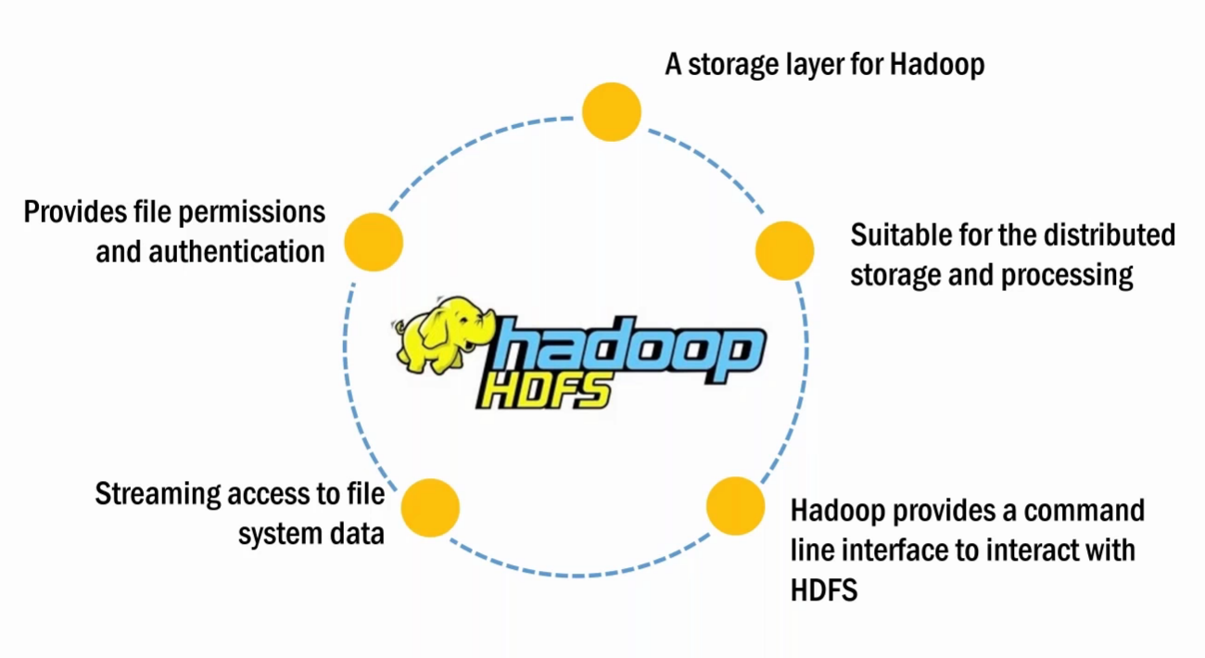
Hadoop Distributed File System

Slide 18
HDFS Architecture
NameNode
Secondary
NameNode
Master
Slave
DataNode
DataNode
DataNode

Slide 19
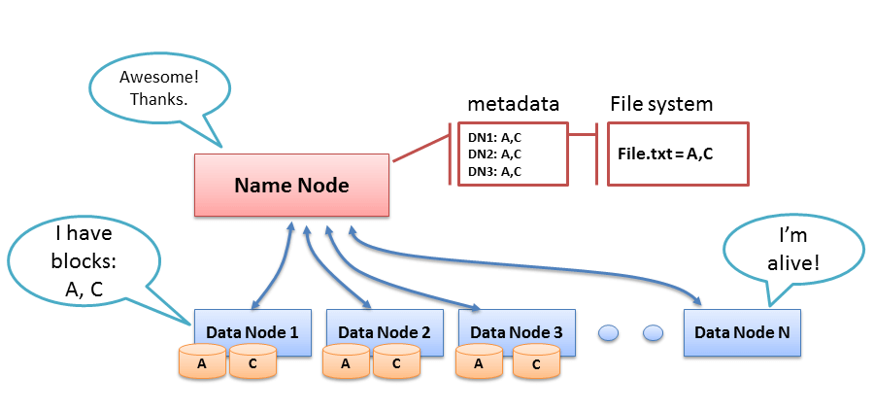
HDFS Operation Principle
The HDFS components comprise different servers like NameNode, DataNode and Secondary NameNode.

Slide 20
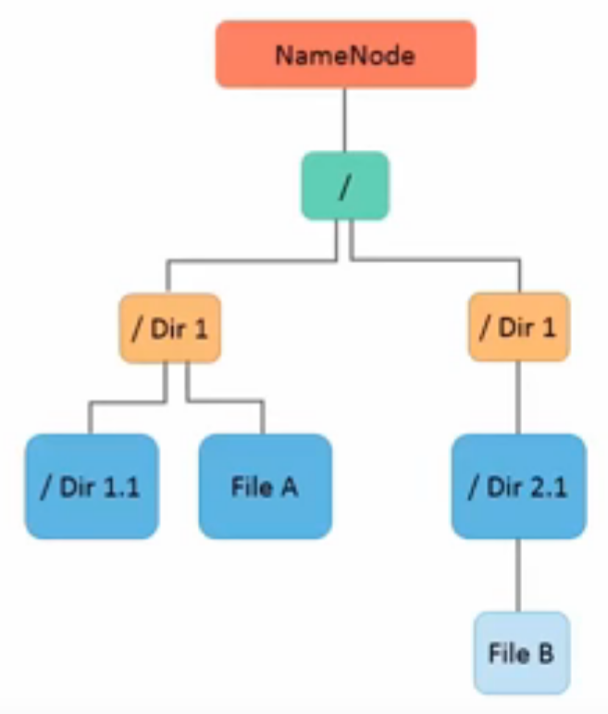
File System Namespace
The characteristics of HDFS file system are as follows:
Allows user data to be stored in files
Follows a hierarchical file system with directories and files
Supports operations such as create, remove, move and rename

Slide 21
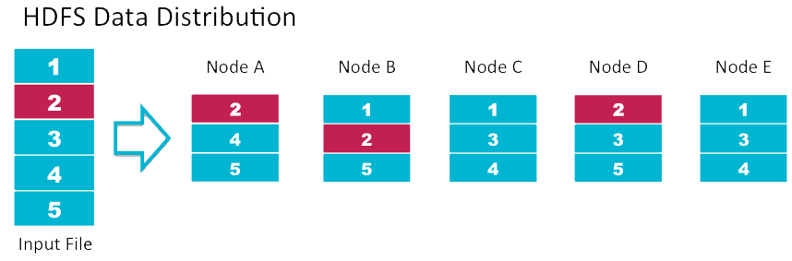
Data Block Split
Each file is split into one or more blocks and replicated in DataNodes.
DataNodes manages names and locations of file blocks, which are 64MB each by default.
Benefits of Data Block Approach:
Simplified replication
Fault-tolerance and reliability
Shielding users from storage subsystem details

Slide 22
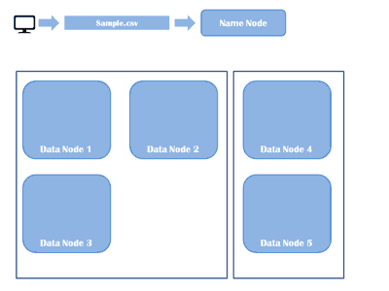
Data Block Split – Contd.

Slide 23
HDFS Access
HDFS provides the following access mechanisms:
Java API for applications
Python access and C language wrapper for non-Java applications
Web GUI utilized through an HTTP browser
FS shell for executing commands on HDFS

Slide 24
YARN

Slide 25
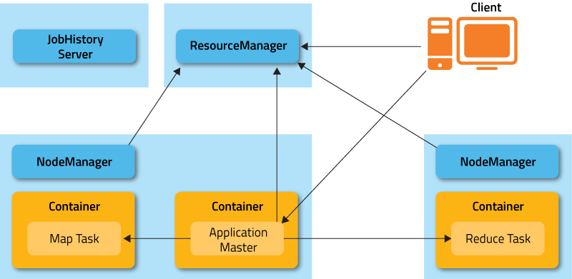
Yet Another Resource Negotiator
YARN is the part of Hadoop that helps multiple data processing engines to handle data stored in a single platform

Slide 26
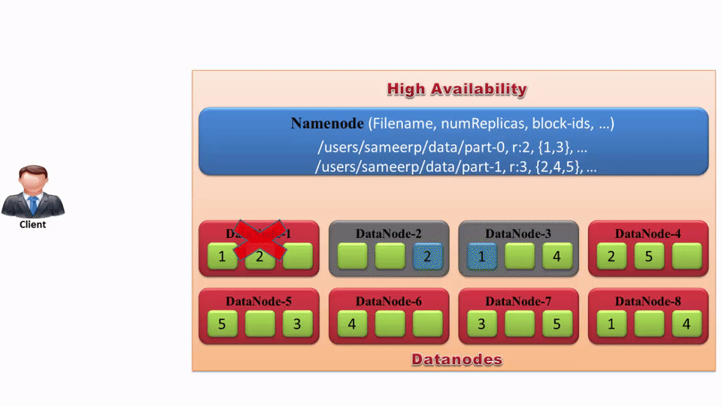
YARN - Flow

Slide 27
MapReduce

Slide 28

Big Data Ecosystem
Streaming Engines
Data Store
Data Processing
Peripherals
Data Services
Distributions
Cloud Exposure

Slide 29
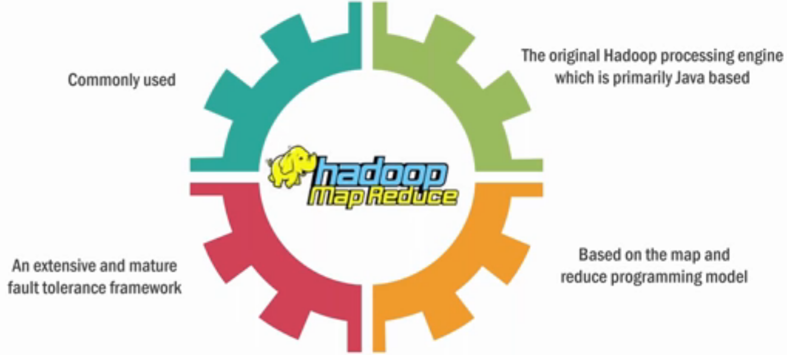
MapReduce

Slide 30
MapReduce
MapReduce is a programming model, and an associated implementation for processing and generating large data sets with parallel and distributed algorithms on a cluster.
MapReduce operation includes:
Specify computation in terms of map and reduce function
Parallel computation across large-scale clusters of machines
Handle machine failures and performance issues
Ensure efficient communication between the nodes
MapReduce can be applied to significantly large datasets when compared to “commodity” servers

Slide 31
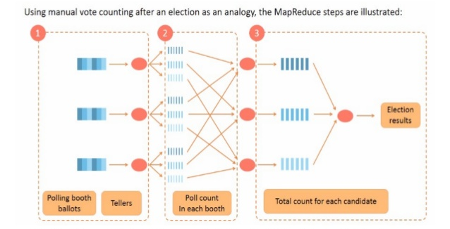
MapReduce - Analogy
Step 1 – Input splitting: Each poll booth’s ballot papers are counted by a teller
Step 2 – Map method: Teller of all booths counts the ballot papers in parallel
Step 3 – Reduce method: The ballot count of each booth under the assembly and parliament seat positions is found and the total count for the candidate in generated

Slide 32

MapReduce – Analogy (contd.)
Conclusion:
The key reason to perform mapping and reducing is to speed up the execution of a specific process by splitting the process into a number of tasks, thus enabling parallel work.

Slide 33
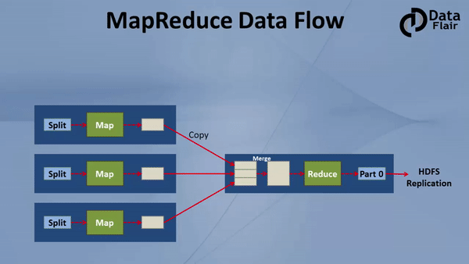
MapReduce – Data Flow

Slide 34
MapReduce - Phases
Input
Refers to providing data for which the MapReduce process is to be performed
Splitting
Refers to converting a job submitted the client into a number of tasks
Mapping
Refers to generating key value pair for the input
Combining
Refers to combining the output of all the Mappers
Shuffling
Refers to sorting the data based on the keys
Reducing
The data is reduced based on the repeated keys by incrementing the value

Slide 35
MapReduce - Steps
The client submits the job to the Job Tracker.
Job Tracker asks NameNode the location of data.
As per the reply from NameNode, the Job Tracker ask respective Task Tracker to execute the task on their data.
All the results are stored on some DataNode and the NameNode is informed about the same.
The Task Tracker inform the job completion and progress to Job Tracker.
The Job Tracker inform the completion to client.
Client contacts the NameNode and retrieve the results.

Slide 36
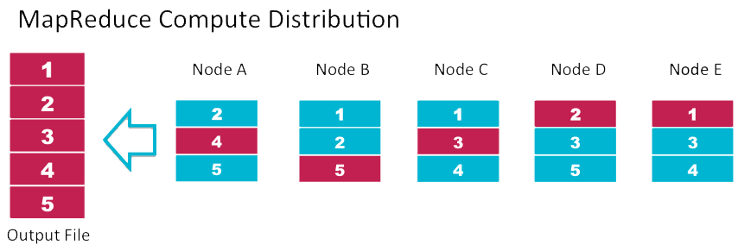
Map Reduce
A massively scalable, parallel processing framework that works with HDFS.

Slide 37
Summary
Hadoop works on three configurations: standalone, pseodo-distributed and fully distributed mode.
The two core components of Apache Hadoop are HDFS and MapReduce.
The HDFS layer contains NameNode, secondary NameNode and DataNode.
HDFS can be used to handle Big Data sets with its inherent features of fault-tolerance, high throughput and streaming data access.

Slide 38
Reference
Hadoop site : https://hadoop.apache.org/
Downloading Hadoop : http://www.apache.org/dyn/closer.cgi/hadoop/
Documentation:
HDFS : https://hadoop.apache.org/docs/r1.2.1/hdfs_design.html
Yarn : http://hadoop.apache.org/docs/current/hadoop-yarn/hadoop-yarn-site/YARN.html
MapReduce : http://hadoop.apache.org/docs/r1.2.1/mapred_tutorial.html

Slide 39
Questions?

Slide 40


Test Yourself
Answer the following questions:
What are the main components of a Hadoop Application?
What is commodity hardware?
What happens to a NameNode that has no data?
What are the phases involved in MapReduce?
Hadoop Common, HDFS, YARN and MapReduce.
Input, Splitting, Mapping, Shuffling and Reducing.
What is shuffling in MapReduce?
Commodity Hardware refers to inexpensive systems that do not have high availability or high quality.
The process by which the system performs the sort and transfers the map outputs to the reducer as inputs is known as the shuffle.
What happens when a DataNode fails?
There does not exist any NameNode without data. If it is a NameNode then it should have some sort of data in it.
Jobtracker and namenode detect the failure
On the failed node all tasks are re-scheduled
Namenode replicates the users data to another node

Slide 41
Assignment
Install Hadoop
Create directory in HDFS using CLI
Delete directory in HDFS using CLI
Copy file from local to HDFS using CLI
Copy file from HDFS to local using CLI
View the directories and files using HDFS Web GUI
Download file from HDFS using Web GUI and validate the file data

